Slide 1
Decision Tree Algorithm

Slide 2
Introduction
A popular machine learning algorithm that can be used for both regression and classification tasks.
They are easy to understand, interpret, and implement.
is a hierarchical model used in decision support that depicts decisions and their potential outcomes, incorporating chance events, resource expenses, and utility.

Slide 3
Introduction
This algorithmic model utilizes conditional control statements and is non-parametric, supervised learning, useful for both classification and regression tasks.
The tree structure is comprised of a root node, branches, internal nodes, and leaf nodes, forming a hierarchical, tree-like structure.
Root Nodes – It is the node present at the beginning of a decision tree from this node the population starts dividing according to various features.
Decision Nodes – the nodes we get after splitting the root nodes are called Decision Node

Slide 4
Introduction
Leaf Nodes – the nodes where further splitting is not possible are called leaf nodes or terminal nodes
Sub-tree – just like a small portion of a graph is called sub-graph similarly a sub-section of this decision tree is called subtree.
Pruning – is nothing but cutting down some nodes to stop overfitting.

Slide 5
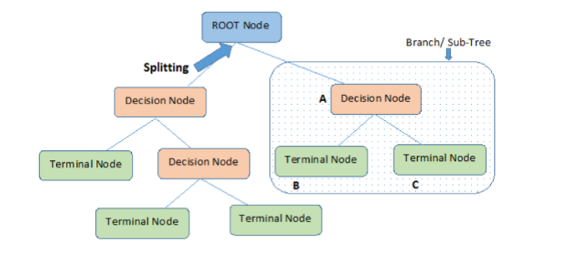
Introduction

Slide 6
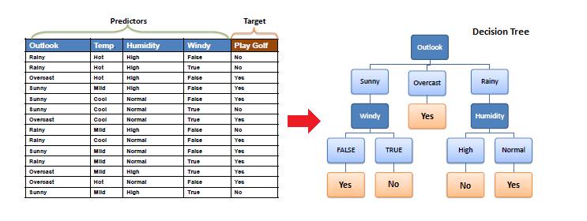
Example of Decision Tree

Slide 7
Algorithm
The core algorithm for building decision trees called ID3 by J. R. Quinlan which employs a top-down, greedy search through the space of possible branches with no backtracking.
ID3 uses Entropy and Information Gain to construct a decision tree.
Entropy
A decision tree is built top-down from a root node and involves partitioning the data into subsets that contain instances with similar values (homogenous).
ID3 algorithm uses entropy to calculate the homogeneity of a sample.
If the sample is completely homogeneous the entropy is zero and if the sample is an equally divided it has entropy of one.

Slide 8
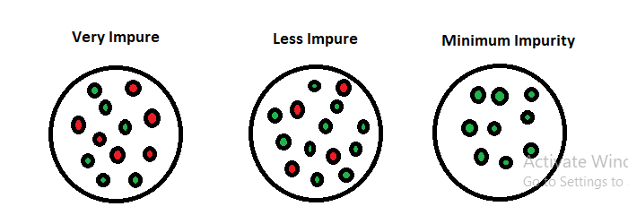
Entropy
Entropy is an information theory metric that measures the impurity or uncertainty in a group of observations.
It determines how a decision tree chooses to split data.
The image below gives a better description of the purity of a set.

Slide 9
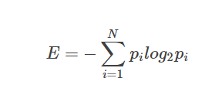
Entropy
Consider a dataset with N classes. The entropy may be calculated using the formula below:
pi is the probability of randomly selecting an example in class i.
Let’s have an example to better our understanding of entropy and its calculation.
Let’s have a dataset made up of three colors; red, purple, and yellow.
If we have one red, three purple, and four yellow observations in our set, our equation becomes:

Slide 10

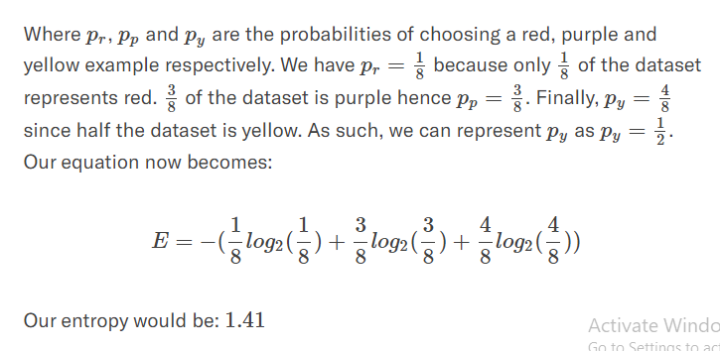
Entropy

Slide 11
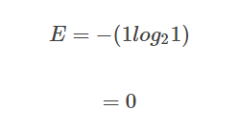
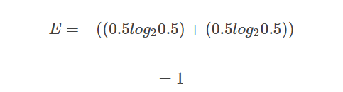
Entropy
what happens when all observations belong to the same class?
In such a case, the entropy will always be zero.
Such a dataset has no impurity.
This implies that such a dataset would not be useful for learning.
However, if we have a dataset with say, two classes, half made up of yellow and the other half being purple, the entropy will be one.
This kind of dataset is good for learning.

Slide 12

Information Gain
We can define information gain as a measure of how much information a feature provides about a class.
Information gain helps to determine the order of attributes in the nodes of a decision tree.
The main node is referred to as the parent node, whereas sub-nodes are known as child nodes.
We can use information gain to determine how good the splitting of nodes in a decision tree.

Slide 13
Information Gain
The term Gain represents information gain.
E_{parent} is the entropy of the parent node and E_{children} is the average entropy of the child nodes.
Suppose we have a dataset with two classes.
This dataset has 5 purple and 5 yellow examples.
The initial value of entropy will be given by the equation below.
Since the dataset is balanced, we expect the answer to be 1.
E_{initial}=−((0.5log20.5)+(0.5log20.5))=1

Slide 14

Information Gain
Say we split the dataset into two branches.
One branch ends up having four values while the other has six.
The left branch has four purples while the right one has five yellows and one purple.
We mentioned that when all the observations belong to the same class, the entropy is zero since the dataset is pure.
As such, the entropy of the left branch E_{left}=0
On the other hand, the right branch has five yellows and one purple. Thus:

Slide 15
Information Gain
A perfect split would have five examples on each branch.
This is clearly not a perfect split, but we can determine how good the split is.
We know the entropy of each of the two branches.
We weight the entropy of each branch by the number of elements each contains.
This helps us calculate the quality of the split.
The one on the left has 4, while the other has 6 out of a total of 10.
Therefore, the weighting goes as shown below:
E_{split}=0.6∗0.65+0.4∗0=0.39

Slide 16
Information Gain
The entropy before the split, which we referred to as initial entropy E_{initial}=1
.After splitting, the current value is 0.39
We can now get our information gain, which is the entropy we “lost” after splitting.
Gain=1–0.39 =0.61
The more the entropy removed, the greater the information gain.
The higher the information gain, the better the split.

Slide 17
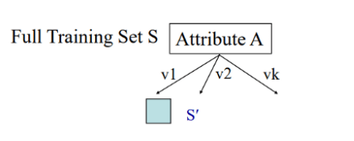
Using Information Gain to Build Decision Trees
An attribute with the highest information gain from a set should be selected as the parent (root) node. From the image below, it is attribute A.
Build child nodes for every value of attribute A.
Repeat iteratively until you finish constructing the whole tree.

Slide 18
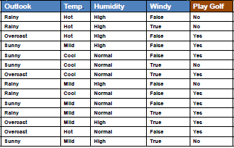
Example
To build a decision tree, we need to calculate two types of entropy using frequency tables as follows:
a) Entropy using the frequency table of one attribute
b) Entropy using the frequency table of two attributes

Slide 19
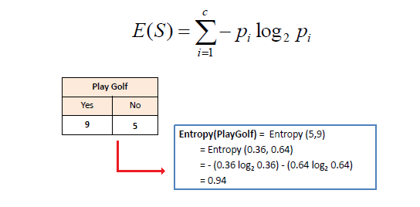
Entropy using the frequency table of one attribute:

Slide 20
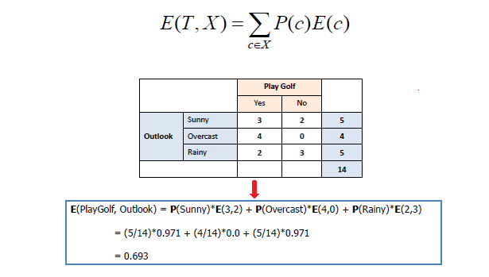
Entropy using the frequency table of two attributes:

Slide 21
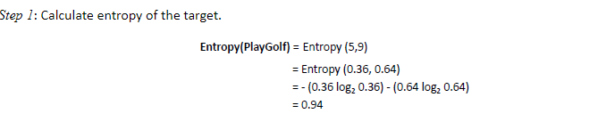
Information Gain
The information gain is based on the decrease in entropy after a dataset is split on an attribute.
Constructing a decision tree is all about finding attribute that returns the highest information gain (i.e., the most homogeneous branches).

Slide 22
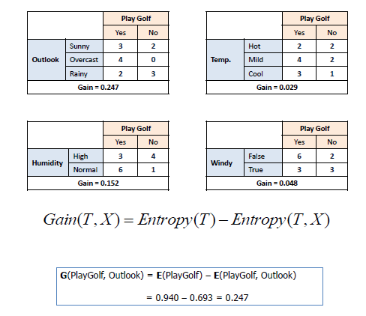
Step 2: The dataset is then split on the different attributes. The entropy for each branch is calculated.
Then it is added proportionally, to get total entropy for the split.
The resulting entropy is subtracted from the entropy before the split.
The result is the Information Gain, or decrease in entropy.

Slide 23
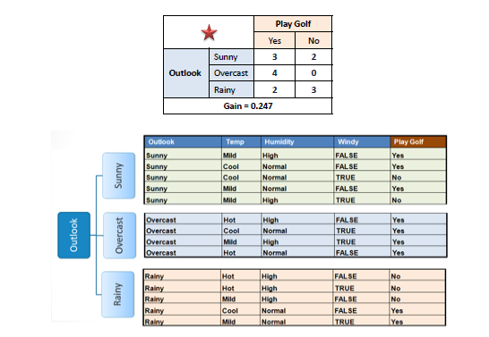
Step 3: Choose attribute with the largest information gain as the decision node, divide the dataset by its branches and repeat the same process on every branch.

Slide 24
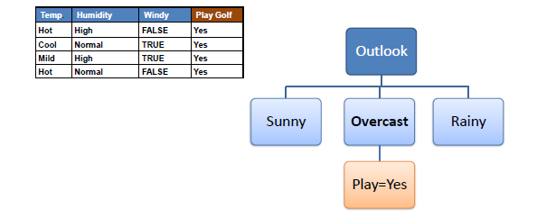
Step 4a: A branch with entropy of 0 is a leaf node.

Slide 25
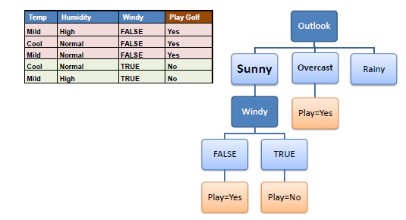
Step 4b: A branch with entropy more than 0 needs further splitting.
Step 5: The ID3 algorithm is run recursively on the non-leaf branches, until all data is classified.

Slide 26
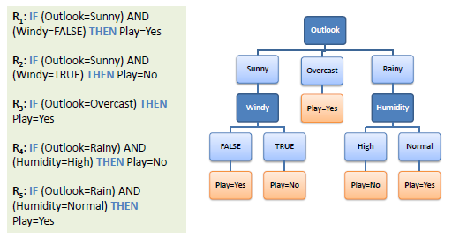
Decision Tree to Decision Rules

Slide 27
Python example
max_depth. Each decision tree has a maximum number of levels permitted. max_depth represents this number.
min_samples_leaf. The minimum sample count storable in a leaf node
Import the required libraries
from sklearn.datasets import load_iris
from sklearn import tree
from matplotlib import pyplot as plt.

Slide 28
Load the Iris dataset
The Iris dataset is a very versatile dataset. It has three classes of irises, namely Setosa, Versicolour, and Virginica.
Each class has fifty samples. The rows of this dataset are the samples.
As for the columns, we have Sepal Length, Sepal Width, Petal Length, and Petal Width.
from sklearn.datasets import load_iris
iris = load_iris()
X = iris.data
y = iris.target

Slide 29
Build and fit decision tree
For this specific example, I used the following pair of lines.
clf = tree.DecisionTreeClassifier(criterion='entropy', max_depth=4,min_samples_leaf=4)
clf.fit(X,y)
Plot the decision tree
fig, ax = plt.subplots(figsize=(6, 6))
tree.plot_tree(clf,ax=ax,feature_names=['sepal length','sepal width','petal length','petal width'])
plt.show()

Slide 30
